Slide 1
PREMIS OWL: key decisions and possible bridgings with METS

Slide 2

PREMIS OWL ontology in a nutshell
Purpose
  Setting up an RDF serialization of the PREMIS data model and dictionary
  While remaining as close as possible to the data dictionary’s clearly defined semantics
Based on the current (2.1) PREMIS DD
At first very close to the XML schema
but we moved towards something more RDF-like:
  from identifiers to URIs
  reusing id.loc.gov controlled vocabularies as much as possible
  bridging PREMIS with other vocabularies as much as possible
Class
property
Object
Class
linkingEvent
Event
subProperty
(sub)Class
File
PREMIS OWL example
OWL modelling (very schematic)

Slide 3
PREMIS OWL: what for?
Possible uses:
  Interlinking some repository description as linked open data? (Not so relevant in Digital Preservation)
  Having an "RDF-ready-to-use" preservation concepts
  RDF serialization of preservation metadata as a data management function in a preservation repository

Slide 4

PREMIS ontology: key decisions
Class
property
Class
subProperty
Intellectual Entity
subClass
RightsStatement
derivationalRelationship
linkingRightsStatement
structuralRelationship
linkingIntellectualEntity
linkingRightsStatement
linkingObject
Copyright Information
License Information
linkingAgent
relationship
Agent
Object
Statute Information
linkingSourceObject
linkingObject
linkingOutcomeObject
linkingAgent
Representation
Bitstream
Event
File
linkingEvent
linkingEvent
Notes:
Representation, file, bistream are 3 particular categories of objects, so in OWL/RDF modelling they are a subclasses of the Object class.
Same for copyrightInformation / licenseInformation / statuteInformation.
Structural and derivational relationships are particular types of relationships between objects. Particular types of structural or derivational relationships are intended to be expressed as controlled vocabularies in id.loc.gov / or locally defined if needed.

Slide 5
PREMIS OWL: bridging with PREMIS vocabularies
An example
http://id.loc.gov/vocabulary/cryptographicHashFunctions
In the ontology:
premis:
Fixity
skos:Concept
premis:messageDigestAlgorithm
Sample description
subject verb object
?fixity rdf:type premis:Fixity;
premis:messageDigestAlgorithm <http://id.loc.gov/vocabulary/cryptographicHashFunctions/md5>.
http://id.loc.gov/vocabulary/cryptographicHashFunctions/md5
http://id.loc.gov/vocabulary/cryptographicHashFunctions/sha-1
http://id.loc.gov/vocabulary/cryptographicHashFunctions/crc-32

Slide 6


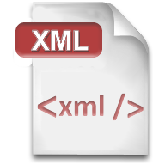
PREMIS OWL: alignment with other vocabularies
relationship
Object
foaf:Agent
ore:AggregatedResource
ore:Aggregation
Bitstream
Representation
Agent
ore:Aggregation
ore:AggregatedResource
File
Notes:
premis:Agent is very close to a foaf:Agent: both are a generic class for software, persons or organizations.
Representation has been modelled as an ore:Aggregation since it basically consists of an aggregation of files
Files are aggregated by Representations, so they are basically ore:AggregatedResources. However, they also aggregate Bistreams. So they also are ore:Aggregations.
Bistreams are AggregatedResources as they are aggregated by Files.

Slide 7
Impact on METS?
PREMIS OWL is NOT a replacement of the PREMIS XML Schema
Thus, it has no impact on the METS XML schema
However it could have some impact on a future RDF serialization of METS
No current RDF version of METS but:
  METS concepts have been partially aligned with ORE concepts
  First attempts to do the same with PREMIS OWL: ORE Aggregation / AggregatedResource concepts as "interoperability common ground"

Slide 8
ORE and PREMIS
ore:
Aggregation
ore:aggregates
(isAggregatedBy)
ore:
AggregatedResource
relationship
Object
ore:AggregatedResource
foaf:Agent
ore:Aggregation
Bitstream
Agent
Representation
ore:aggregates
ore:Aggregation
ore:aggregates
ore:AggregatedResource
File
ore:aggregates (filestreams)
Notes:
Example:
Declaring Representation as an ore:Aggregation and File as an ore:AggregatedResource allows you to link directly a Representation to a File through the ore:aggregates property (that links an Aggregation to an AggregatedResource).
NB in case there are questions on this: we didn’t go so far as to declare "ore:aggregates" as a particular structuralRelationship in the ontology (although it is a structural relationship), since it is not up to us to redefine existing properties.

Slide 9
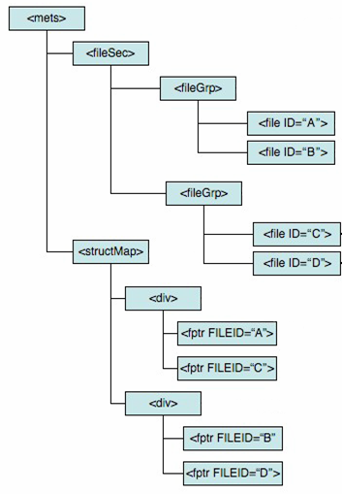

ORE, METS & PREMIS
ore:Aggregation
definitely an aggregation, but which aggregation depends on the implementation
ore:
Aggregated
Resource
Representation
ore:
Aggregation
File
ore:
Aggregated Resource
<stream ID=D1>
ore:Aggregation
Bitstream
Notes:
Note:

Slide 10
Does not prevent other, more precise alignments with a future, hypothetic METS ontology
some high-level div?
(implementation-specific)
Representation
File
<stream ID=D1>
Bitstream

Slide 11
PREMIS OWL: under revision
managing identifiers when they are not URIs
    <file1> premis:identifier <file1-ID>.
    <file1-ID> rdf:type premis:Identifier;
    premis:identifierType "someUniversityIdentifierType";
    premis:identifierValue "12345678".
    OR
    <http://university.edu/local#someIdentifierType> rdfs:subPropertyOf premis:identifier.
    <object1> <http://university.edu/local#someIdentifierType> "12345678".
subject verb object
Easy to use
No controlled
vocab to define
file
description
local vocabulary
Far more concise
Takes advantage of
RDF features
file
description

Slide 12
Next steps?
PREMIS 2.1 "OWL version" under revision
  Comments welcome! http://premisontologypublic.pbworks.com/w/page/45987628/Questions%20for%20reviewers
  Revision deadline: nov, 10th
More controlled vocabularies in the future at id.loc.gov
Bound to evolve with PREMIS 3.0 (currently being finalized)

